Slide 1
Mobile-Commerce Development
Lesson
Layout and Basic Views
Lecturer:
Tran Duy Thanh, Phd
Nguyen Quang Phuc, Msc
Email: thanhtd@uel.edu.vn
Blog: https://tranduythanh.com
Phone: 0987773061

Slide 2
Lesson Objective
-Understand the importance of layout in design
-Understand and apply layouts: Frame layout, Linear layout, Table layout, Relative Layout and Constraint layout
-Use the findById method for view accessing
-Understand and apply basic views in design, such as: TextView, Edittext, Button, CheckBox, RadioButton, ImageView, ImageButton

Slide 3
Outlines
Layout Overview
Frame Layout
Linear Layout
Table Layout
Relative Layout
Constraint Layout
findViewById method
Basic Views: TextView, EditText, Button, CheckBox, etc.

Slide 4
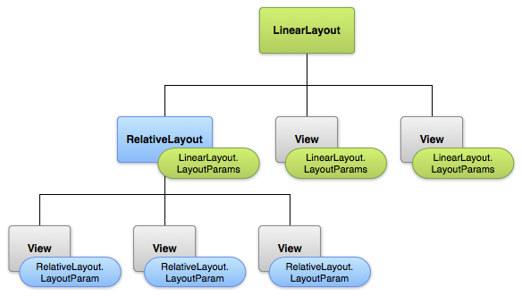
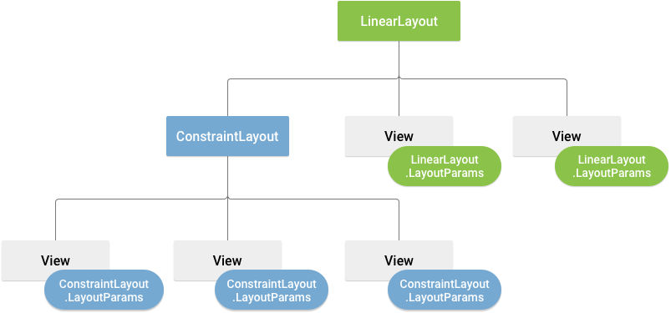
1. Layout Overview
Layout is the place to organize controls/Views on the interface. When designing the interface, we must use Layouts to arrange appropriately.

Slide 5
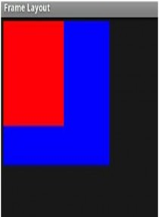
2. Frame Layout
Use in cases of building an organizational layout that displays a single object.
The object defaults to the top-left position on the FrameLayout, you can use the Gravity property to reset the position.
For example:
<FrameLayout xmlns:android="http://schemas.android.com/apk/res/android"
android:layout_width="match_parent"
android:layout_height="match_parent” >
</FrameLayout>

Slide 6
2. Frame Layout
<?xml version=″1.0″ encoding=″utf-8″?>
<FrameLayout android:id=″@+id/mainlayout″ android:layout_height=″fill_parent″ android:layout_width=″fill_parent″ android:orientation=″vertical″ xmlns:android=″http://schemas.android.com/apk/res/android″>
<ImageView android:layout_height=″wrap_content″ android:layout_width=″wrap_content″ android:padding=″5px″ android:src=″@drawable/blue″/>
<ImageView android:layout_height=″wrap_content″ android:layout_width=″wrap_content″ android:padding=″5px″ android:src=″@drawable/red″/>
</FrameLayout>
– You see, red and blue images are always "anchored" in the left corner of the screen. The red image inserted later will overlap the blue image.

Slide 7
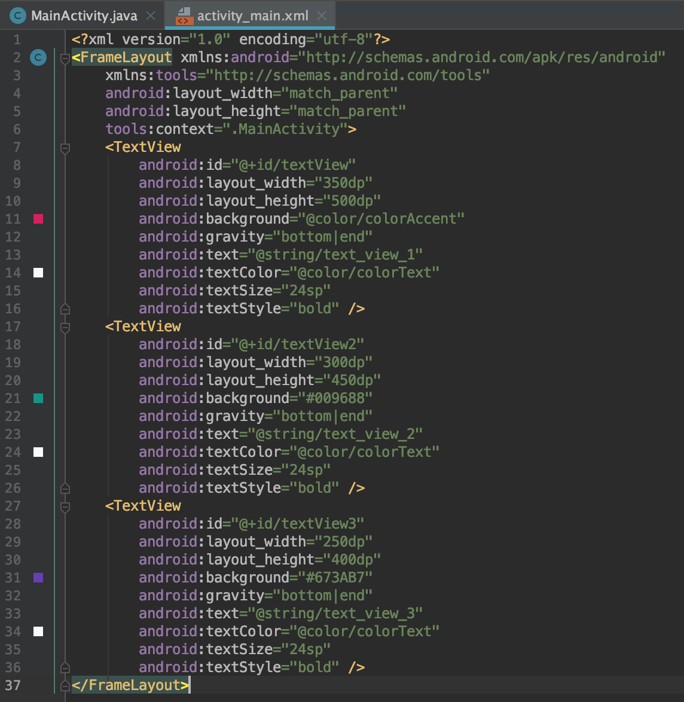
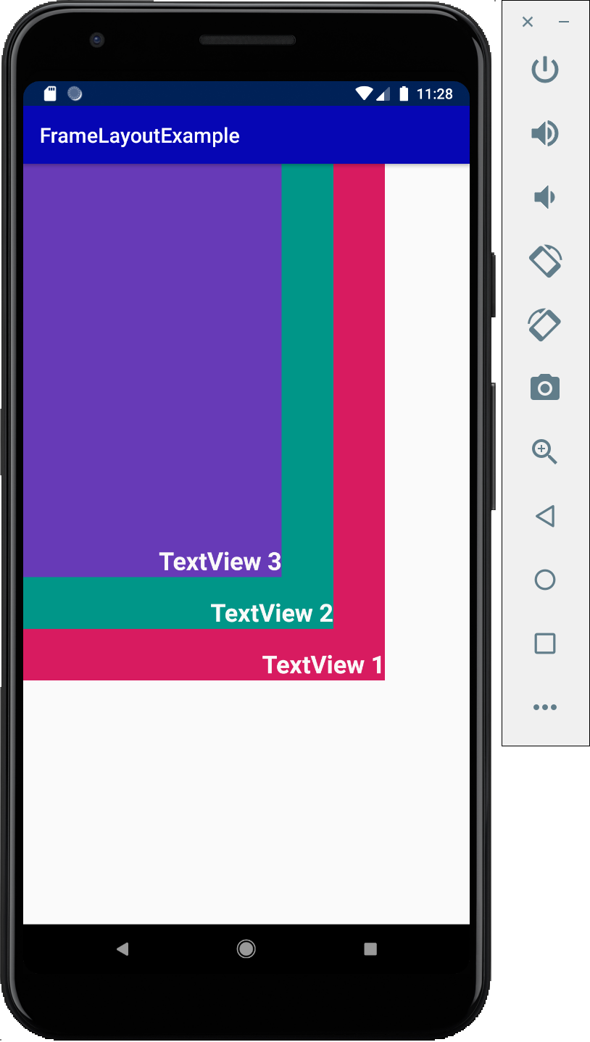
2. Frame Layout

Slide 8
3. Linear Layout
Used in cases of building organizational layouts that display objects in a single direction (vertical or horizontal).
The object defaults to the top left position on LinearLayout , you can use the Gravity property to reset the position.
Example:
<LinearLayout xmlns:android="http://schemas.android.com/apk/res/android"
android:layout_width="match_parent"
android:layout_height="match_parent”
android:orientation=“vertical” >
</LinearLayout>

Slide 9
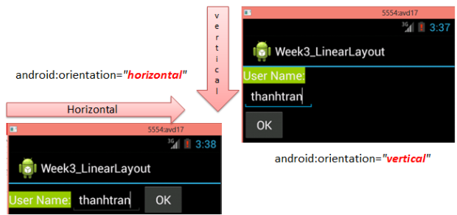
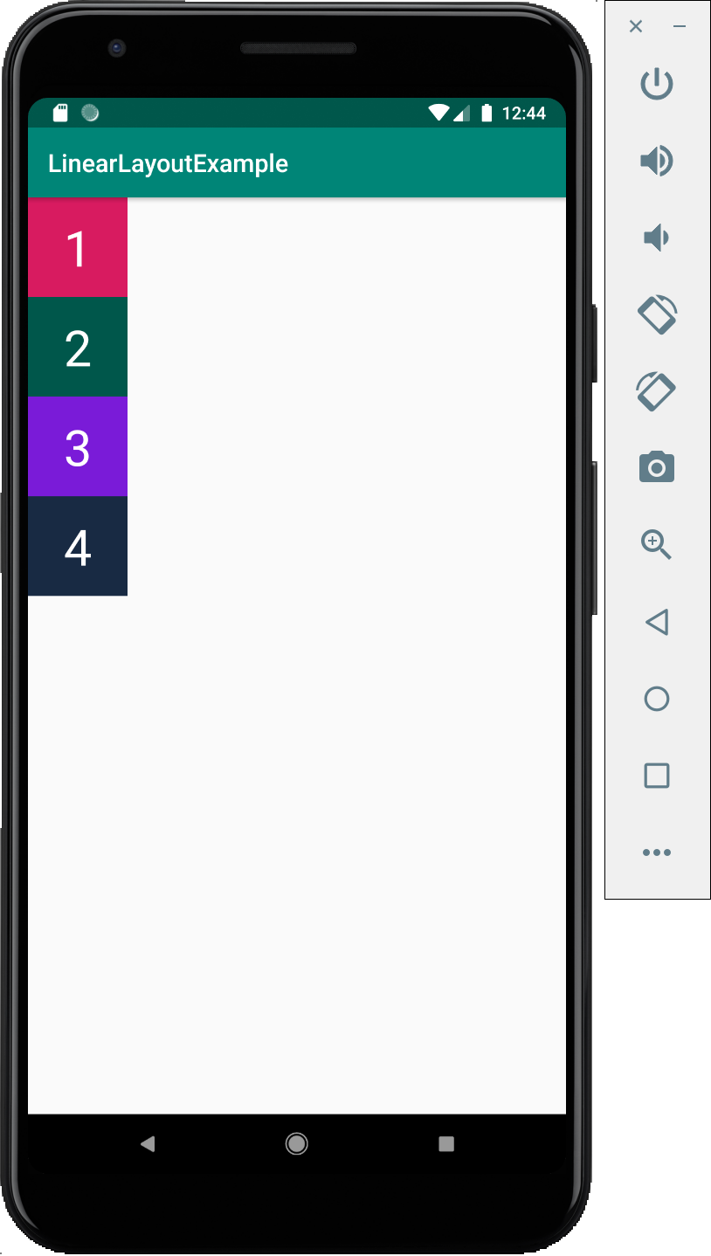
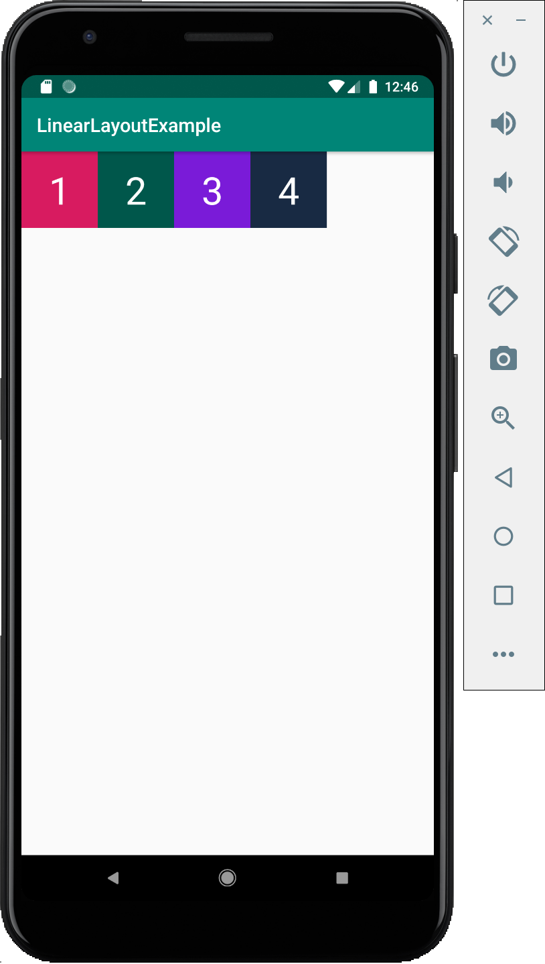
3. Linear Layout
Vertical
Horizontal

Slide 10
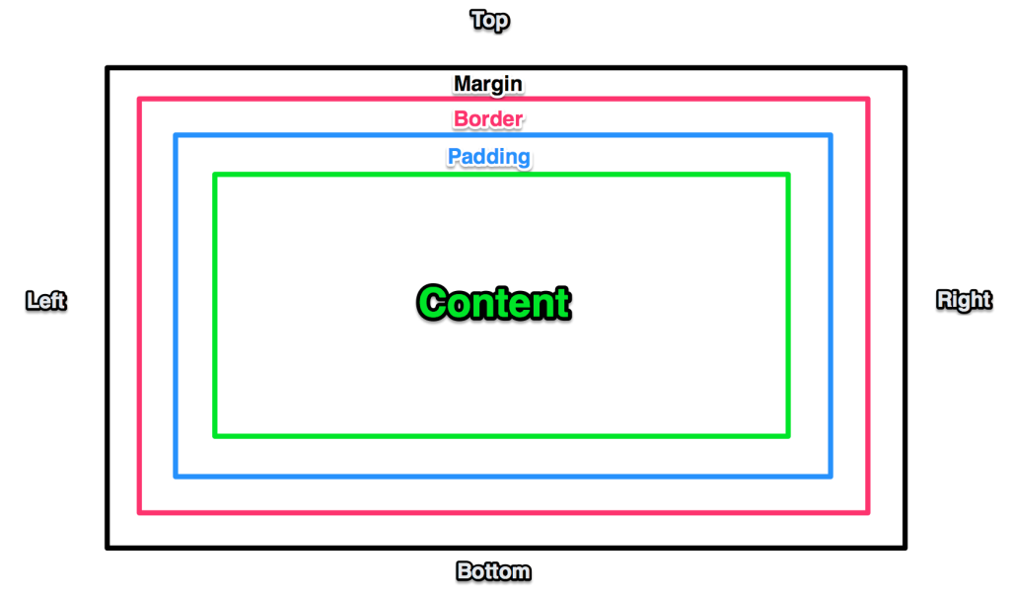
3. Linear Layout
Some design support properties: margin, padding, gravity, weight, ...

Slide 11
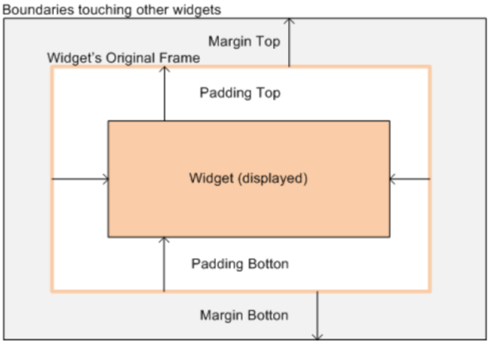
3. Linear Layout
Some design support properties: margin, padding, gravity, weight, ...

Slide 12
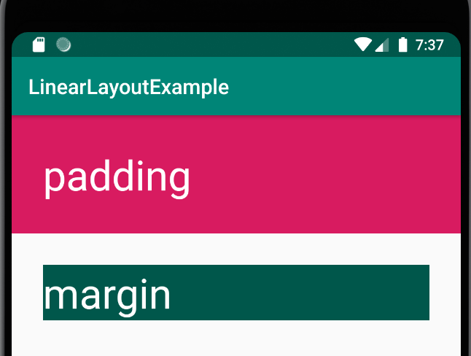
3. Linear Layout
Design support properties: margin, padding
➔ Padding (internal spacing - distance between internal content and control border)
➔ Margin (external spacing – distance between one control and another)
android:padding="30dp"
android:layout_margin="30dp"

Slide 13
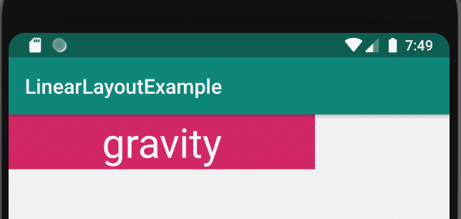
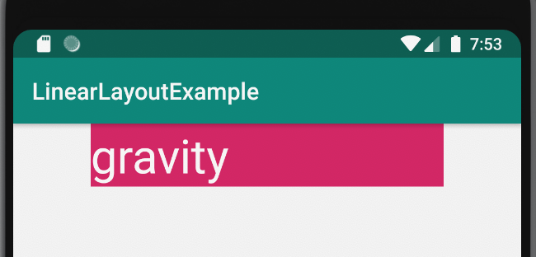
3. Linear Layout
Design support properties: gravity
android:gravity=“center”
android:layout_gravity=“center”

Slide 14
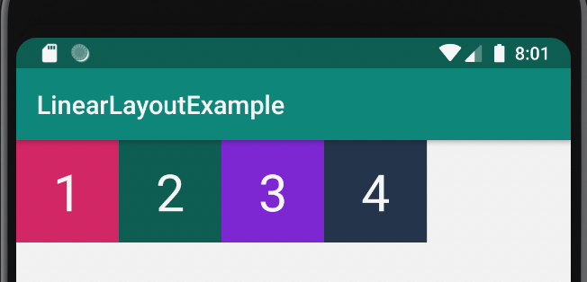
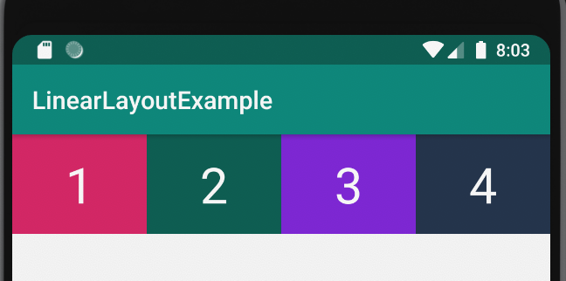
3. Linear Layout
Design support properties: weight
android:layout_weight=“1”
➔ The “layout_weight” attribute helps divide the display ratio of the views evenly.

Slide 15
4. Table Layout
TableLayout inherits from LinearLayout, allowing objects to be displayed in tabular form. The TableRow view object represents each row, inside the TableRow contains child Views, each child View is located in a table cell (cell).
Columns / rows in TableLayout count from position 0.
TableLayout will see which row has the most views to determine how many columns it has.

Slide 16
4. Table Layout
<TableLayout
xmlns:android="http://schemas.android.com/apk/res/android"
android:layout_width="match_parent"
android:layout_height="match_parent” >
<Tablerow>
<Button/>
</Tablerow>
</TableLayout>

Slide 17
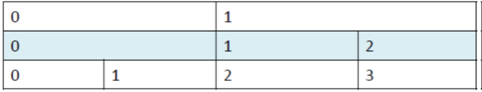
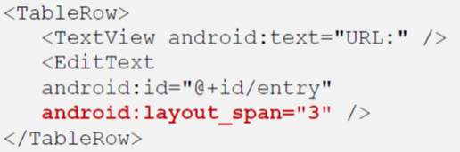
4. Table Layout
– TableLayout will see which row has the most number of controls to determine how many columns it has (take the line with the most number of controls as the standard number of columns).
➔-So according to the image above, you have to say that this TableLayout has 4 columns and 3 rows.
Use layout_span to merge columns:

Slide 18
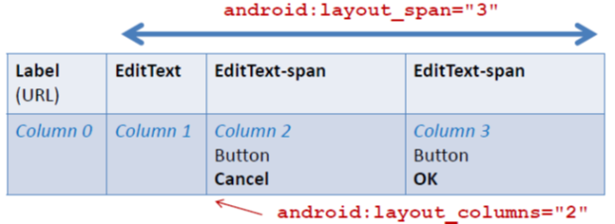

4. Table Layout
Use layout_column to move the control's position to a certain column on a line:
Use stretchColumns to stretch controls and cells evenly (we often use the “*”):

Slide 19
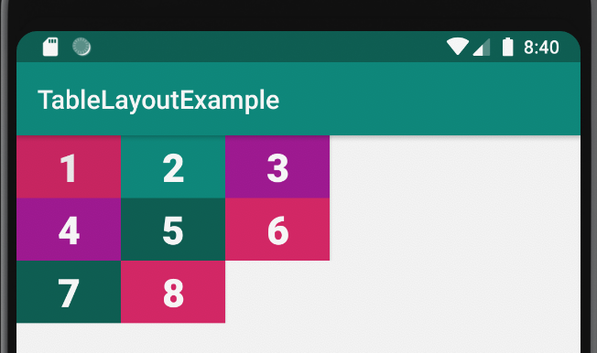
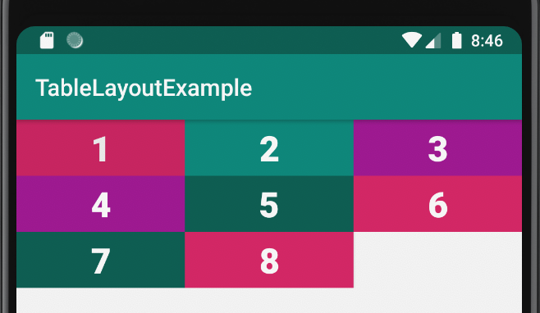
4. Table Layout
<TableLayout xmlns:android="http://schemas.android.com/apk/res/android" xmlns:tools="http://schemas.android.com/tools" android:layout_width="match_parent" android:layout_height="match_parent" tools:context=".MainActivity" android:stretchColumns="*">
</TableLayout>

Slide 20
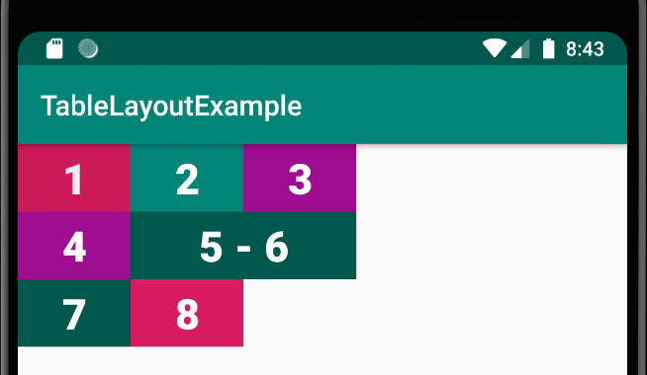
4. Table Layout
<Button android:id="@+id/button5" android:layout_width="80dp" android:layout_height="wrap_content" android:background="@color/…" android:text="5 - 6" android:textColor="@color/mauTrang" android:textSize="30sp" android:textStyle="bold" android:layout_span="2"/>

Slide 21
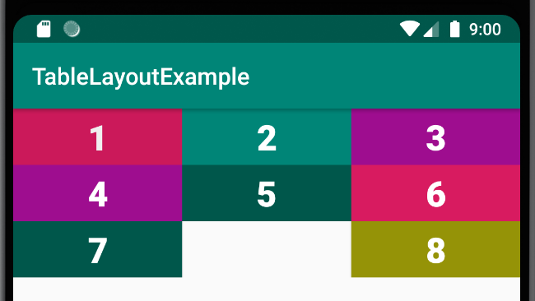
4. Table Layout
<Button android:id="@+id/button8" android:layout_width="80dp" android:layout_height="wrap_content" android:layout_column="2" android:background="#959307" android:text="8" android:textColor="@color/mauTrang" android:textSize="30sp" android:textStyle="bold" />

Slide 22
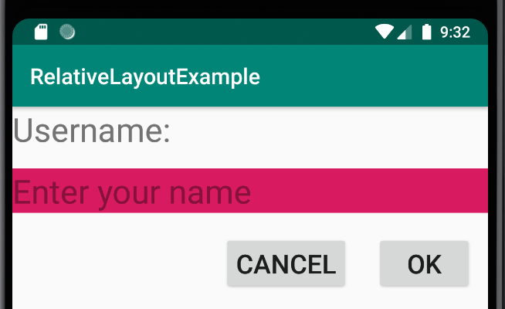
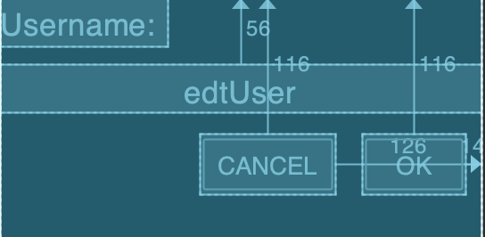
5. Relative Layout
RelativeLayout is a type of Layout in which the position of each child view will be determined relative to other views or to their parent component via ID.
<Button android:id="@+id/btnOk" ……. android:layout_alignParentTop="true" android:layout_alignParentEnd="true" android:layout_marginTop="116dp" android:layout_marginEnd="14dp" ……./>

Slide 23
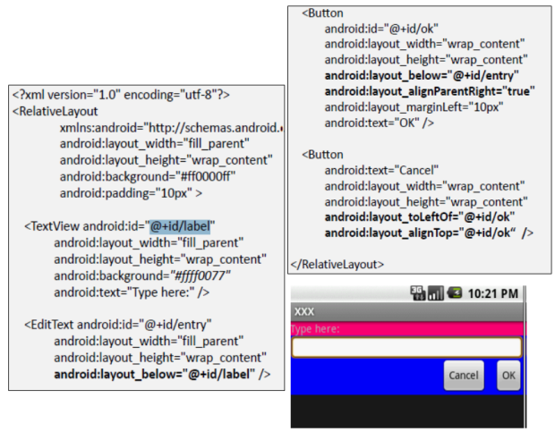
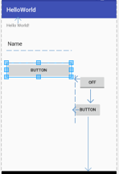
5. Relative Layout

Slide 24
6. Constraint Layout
ConstraintLayout helps design interfaces with certain constraints and linking principles between components (views).
Each view must have at least one horizontal anchor point and one vertical anchor point.

Slide 25
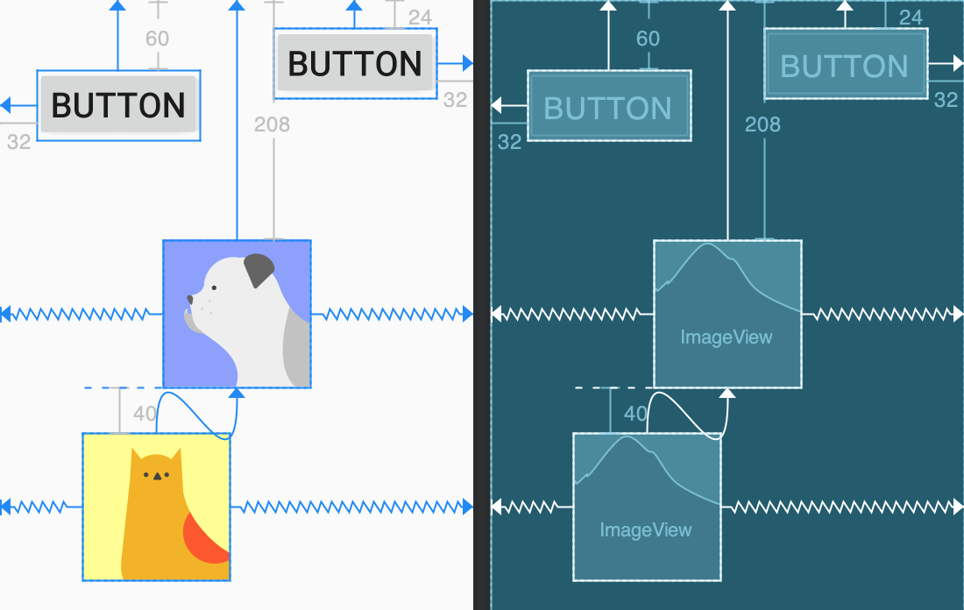
6. Constraint Layout
Create constraint

Slide 26
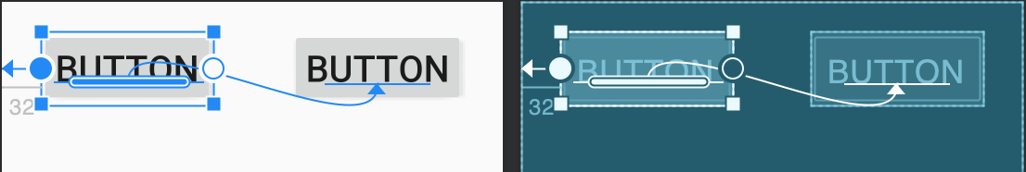
6. Constraint Layout
Create baseline constraint
➔ Baseline constraint helps align the position of views based on the text inside, suitable for views such as: TextView, EditText, Button, ...

Slide 27
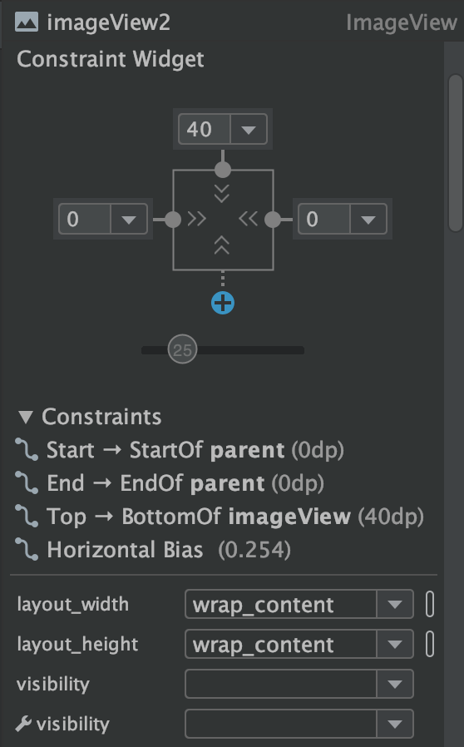
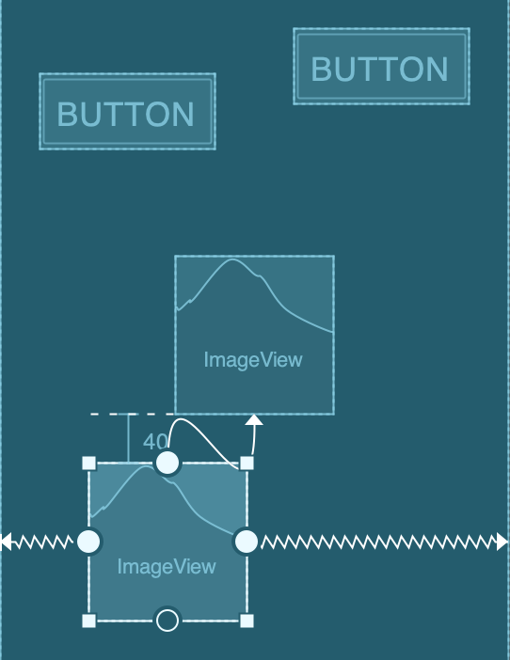
6. Constraint Layout
Create constraint
Margin
Bias
Distance

Slide 28
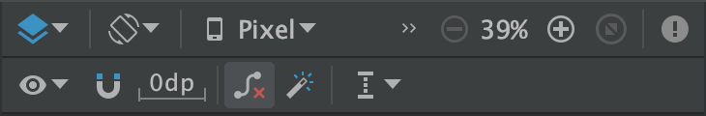
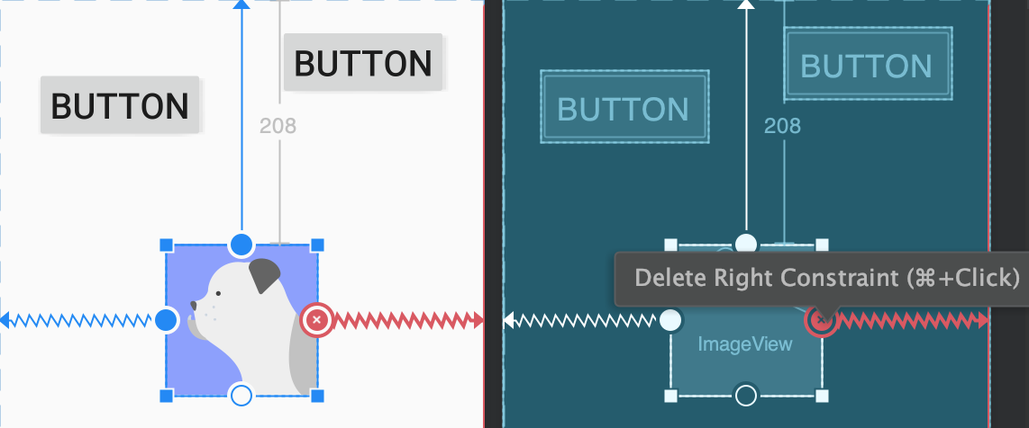
6. Constraint Layout
Remove constraint

Slide 29
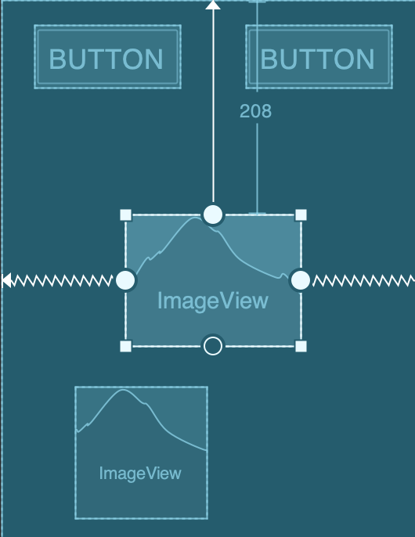
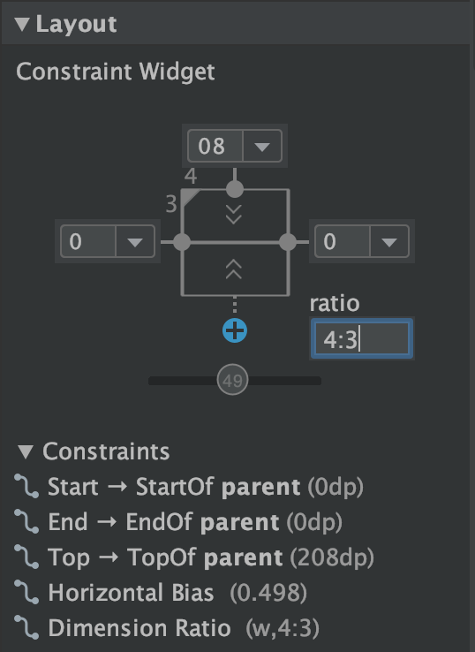
6. Constraint Layout
Ratio -> Adjust view size proportionally

Slide 30
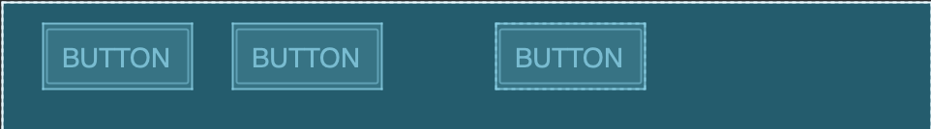
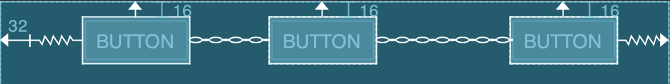
6. Constraint Layout
Chain -> chain views
Create chain: Choose all Views → Right click → Chains → Create Horizontal/Vertical Chain

Slide 31
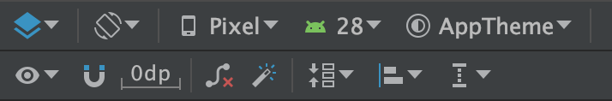
6. Constraint Layout
Some other features
Default margin
Pack
Autoconnection
Infer constraints
Align
Guidelines

Slide 32
7. findViewById method
Called "android naming conventions" and also depends on the programmer's mindset
Button➔btn
TextView➔txt
EditText➔txt, edt
RadioButton➔rad
CheckBox➔chk
ListView➔lv
Need to set a memorable Id. Id is defined in int type, used for Programmers to interact with software resources. But this Id will be automatically saved in R.java
Setting the Id must be the same as setting the variable name, otherwise an error will occur and R.java cannot arise.

Slide 33
7. findViewById method
Graphic User Interface:
<Button android:id="@+id/btnOk" android:layout_width="wrap_content" android:layout_height="wrap_content" android:text="@string/my_button_text"/>
Event Processing:
Button btnOk = (Button)findViewById(R.id.btnOk);
findViewById accesses the Control/view in memory based on the id.

Slide 34
8. Basic Views
8.1. TextView
8.2. EditText
8.3. Button
8.4. CheckBox
8.5. RadioButton
8.6. ImageButton
8.7. ImageView

Slide 35
8.1. TextView
Used to display text data, not allowing editing, usually named with the prefix txt.
Set display content:
Java code (Activity):
XML:
textView.setText("TextView");
android:text="TextView"

Slide 36
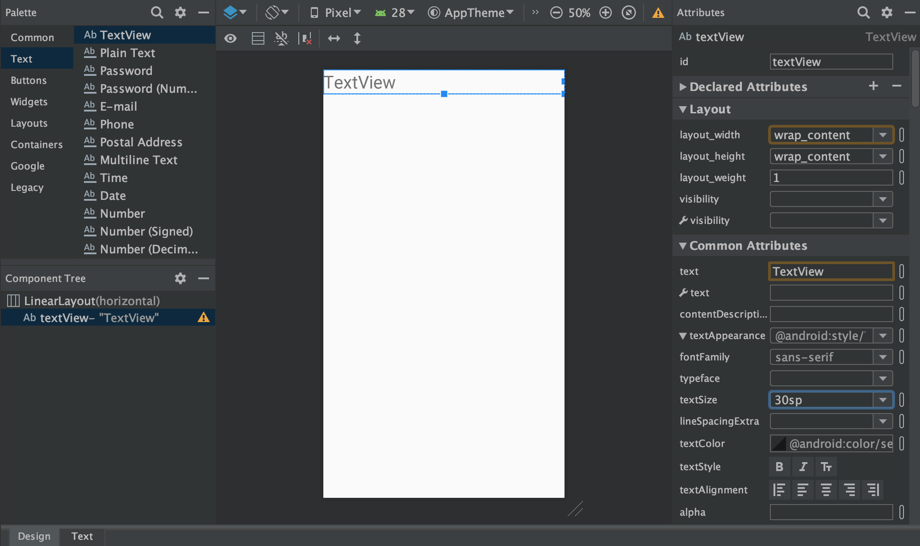
8.1. TextView

Slide 37
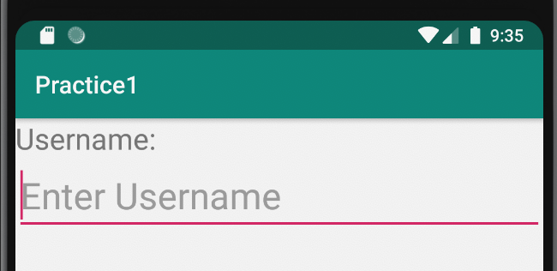
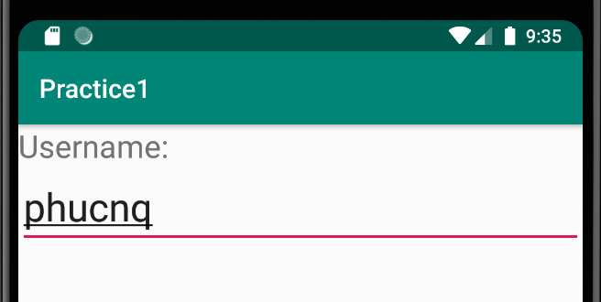
8.2. EditText
Used to display and change text data, usually named with the prefix edt.
Has the same properties as TextView.

Slide 38
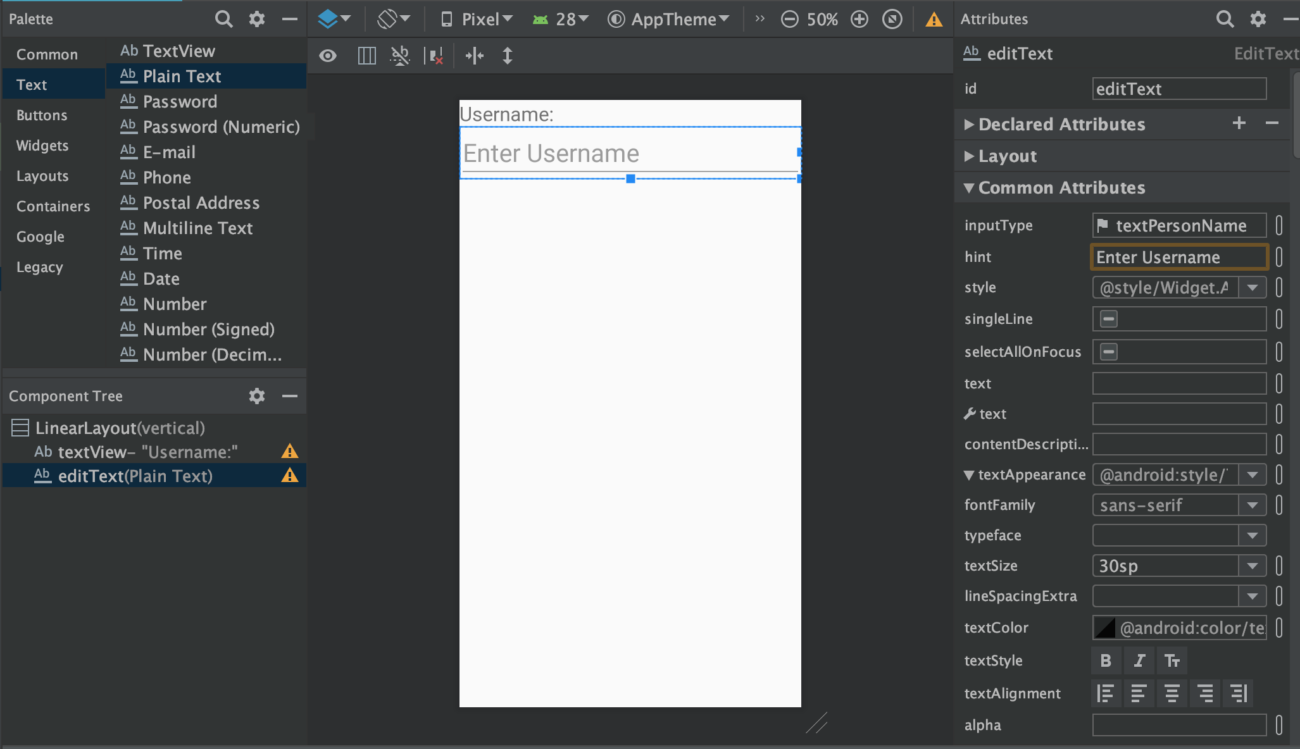
8.2. EditText

Slide 39
8.3. Button
Allows displaying text and image data; usually named with the prefix btn.
Receive and respond to “tap” interactions from users.
Listen to events:
Java code:
btnSubmit = findViewById(R.id.btnSubmit);
btnSubmit.setOnClickListener(new View.OnClickListener() {
@Override
public void onClick(View view) {
//Process here...
}
});
XML:
android:onClick=“MethodName”

Slide 40
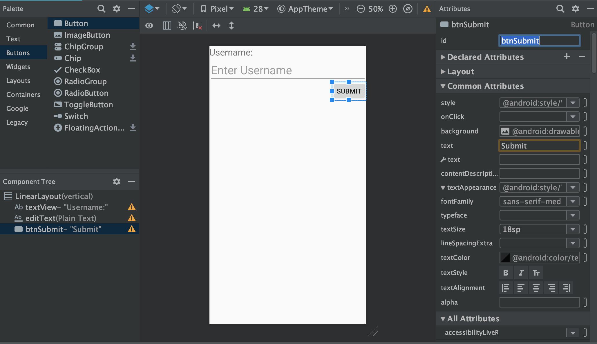
8.3. Button

Slide 41
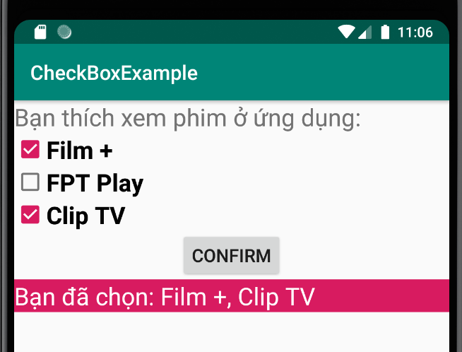
8.4. CheckBox
Allows multiple options to be selected, usually named with the chk prefix.

Slide 42
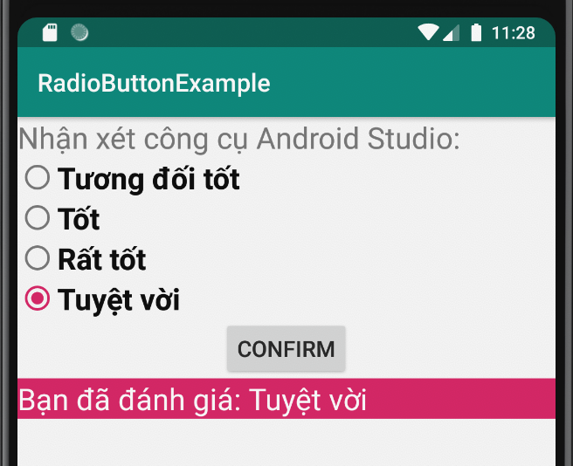
8.5. RadioButton
Allows the selection of only one option, usually named with the prefix rad.

Slide 43
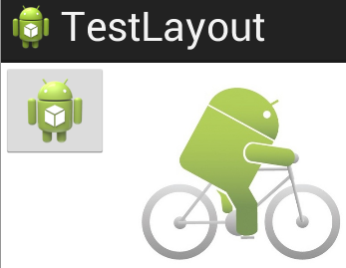
8.6. ImageButton
ImageButton is a Button that can contain images, can set prefix btn, imgBtn

Slide 44
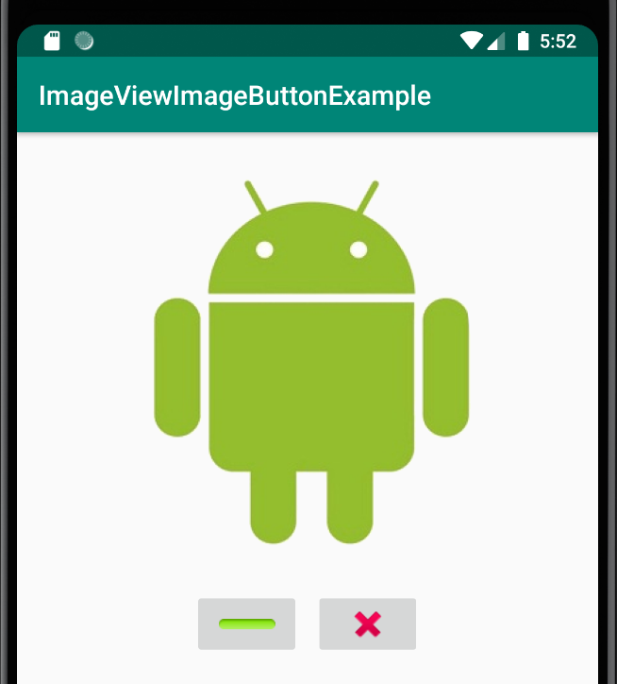
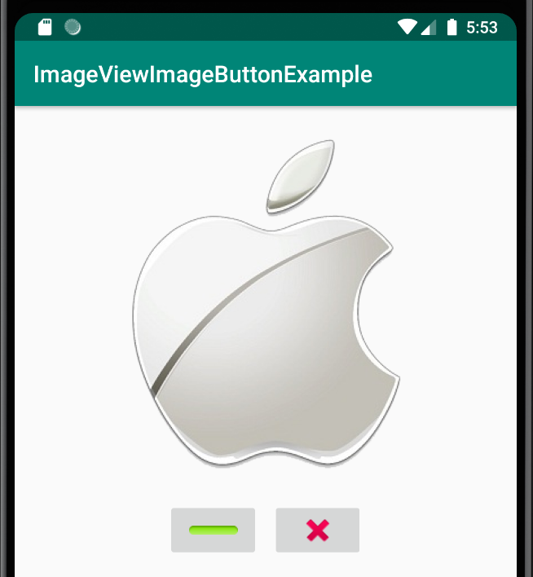
8.6. ImageButton
Change Image
Close

Slide 45
8.7. ImageView
ImageView is a control/view used to display images, allowing interaction. You can always replace ImageButton by designing beautiful 3D images

Slide 46
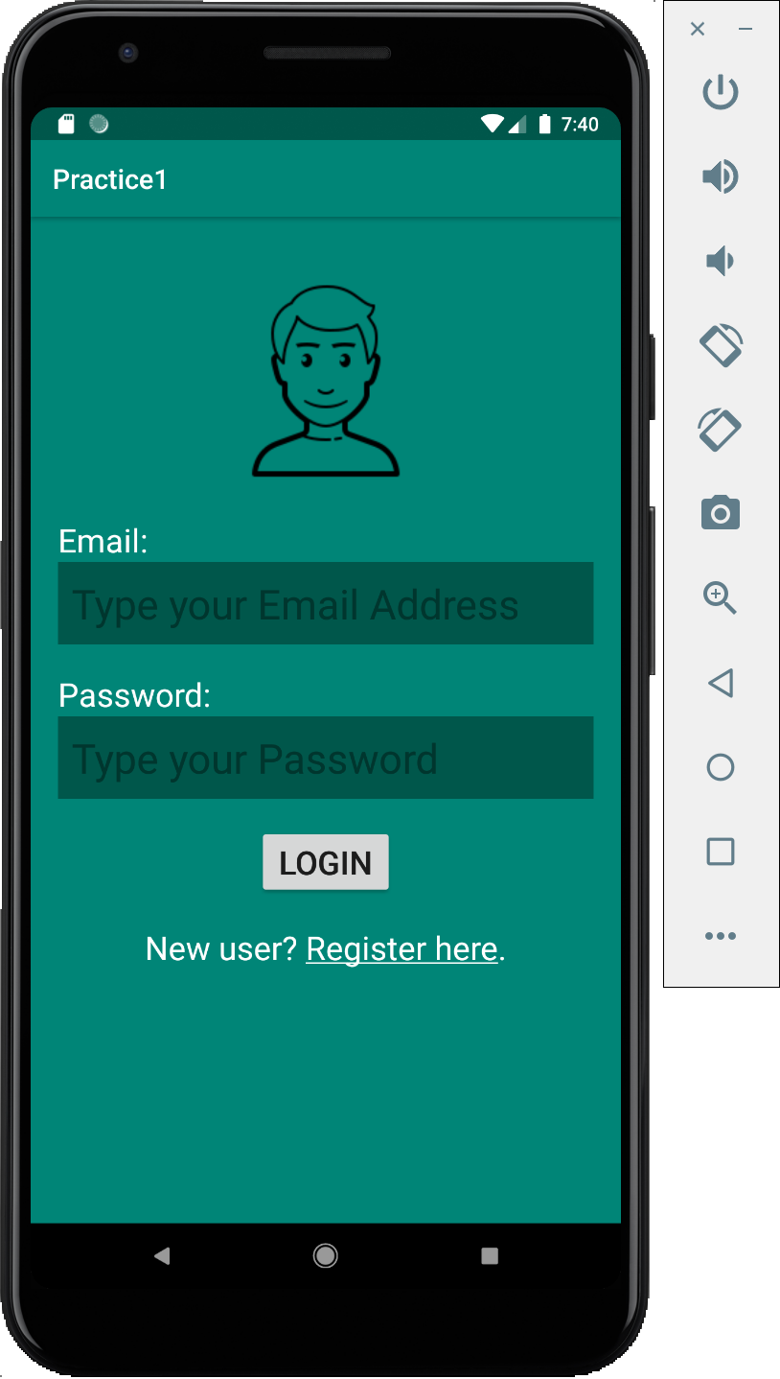
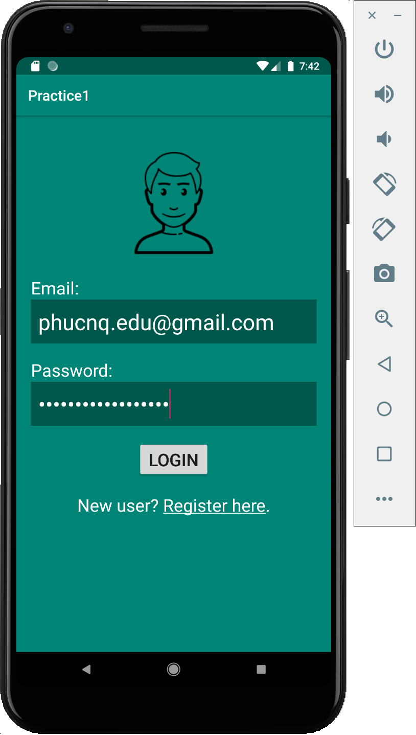
Demo

Slide 47
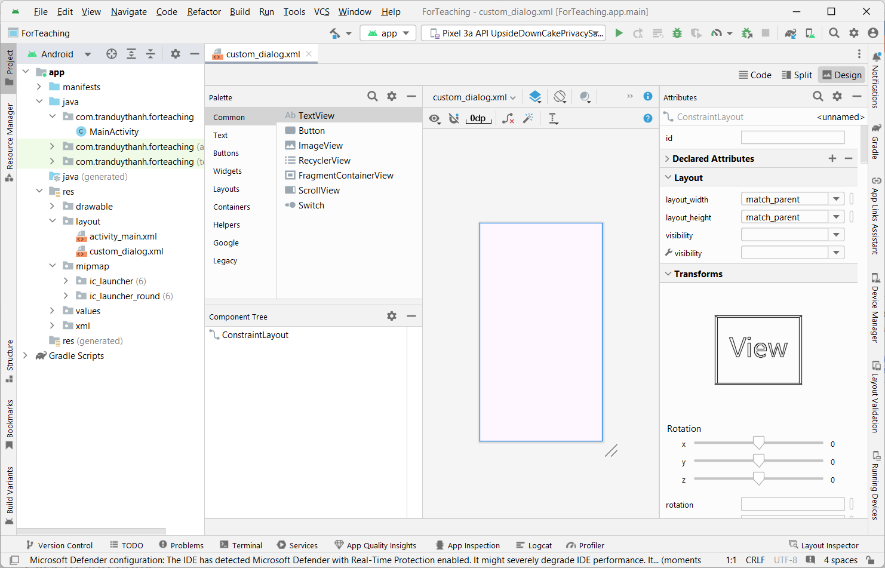

Switch UI for Android Studio
We can switch the UI for Android Studio
Classic UI
New UI

Slide 48


Switch UI for Android Studio
Switch to new UI

Slide 49

Switch UI for Android Studio
Switch to Classic UI….

Slide 50
Discussions
Q1: Why must we use Layout when designing interfaces?
Q2: Distinguish between Margin and Padding
Q3: Present the working mechanism of Table Layout
Q3: Present the working mechanism of Constraint Layout
Q4: Present the working mechanism of findViewById function
Q5: How do we assign events to Button?
Q6: When do we use CheckBox, When do we use RadioButton?

Slide 51
Next Lesson
Events Handling in Android
Onclick XML
Anonymous Listener
Variable as Listener
Activity as Listener
Explicit class Listener
View Subclassing

Slide 52
THANK YOU!

